Slide 1
2025-08-08 Update
Penultimate update!

Slide 2
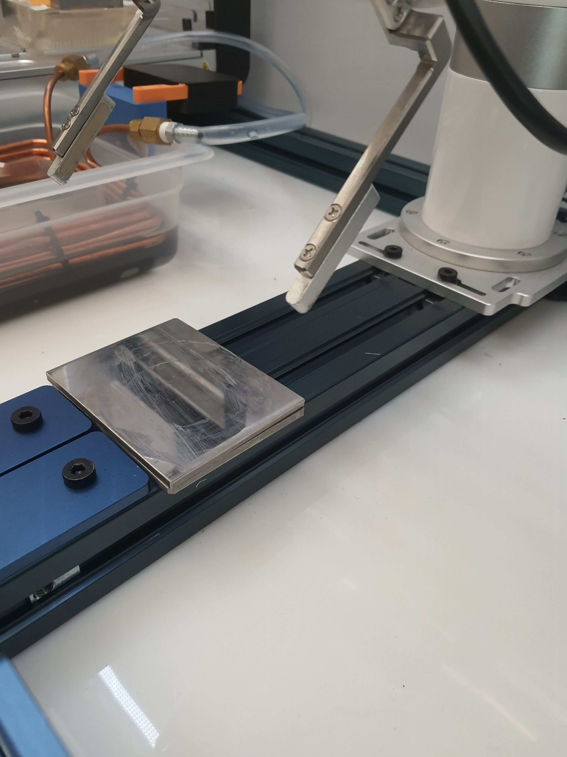
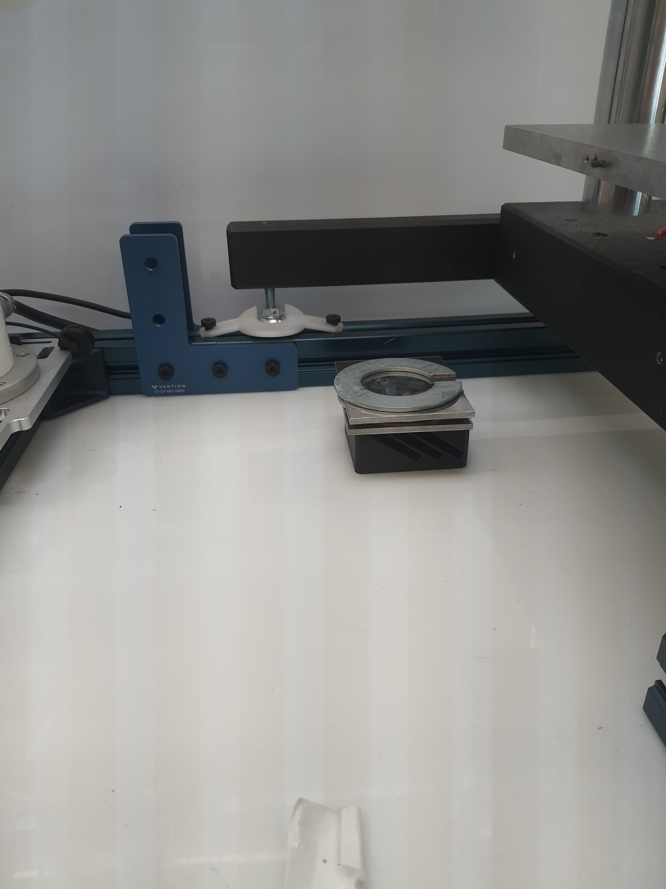

Slide 3
Code
Arm done!
Opentrons code mostly works!
Simple fix to find the next tip in the tip rack
Only tested drawing premixed solution, but theoretically mixing works
Arduino code works!
Fixed a buffer overflow that caused the Arduino to think the compression test was done prematurely
Chiller code works!
Use /dev/serial/by-id/* instead of /dev/ttyACM*

Slide 4
Arm Update
Done!
Pick up knife, do bladecast, put down knife ☑
Clean knife ☑
Put N2 cap on coupon, move to bath, remove cap ☑
May need to tune timing for cap, not sure how long it should be
Put the rings on ☑
Move coupon to tester ☑
Discard coupon ☑
Currently just stacks discarded coupons & rings, will design a fixture
Get new coupon ☑
Coupons are stacked on T-Slot, will design fixture

Slide 5
Relliabilty
Was able to run 2 tests back to back fully autonomously (just press start and watch it run)
Only have 2 rings so can’t test more than 2 in a row
Ring stand only holds 3, will modify to hold more
Worried about gripper when holding the coupon horizontally
Running out of polymer solution to test with

Slide 6
Gripper arms
Little rubber/silicone grips
Coupon

Slide 7
Gripper arms
Little rubber/silicone grips
Coupon
Compression tester plate

Slide 8
Plan
Better grips for arm?
TPU should have arrived by now, see if it’s grippy enough
Design magazine to store clean coupons? And discard pile for used ones?
Currently we just stack them which works fine but proper stand would be nice
Move all tunable parameters for single run to a single space and allow a way for the active learning model to change them
Pull them from a .json file that can be updated by the other program?
Run an http server and listen for a get request with the parameters?

